Slide 1
Graphs
Pg 549
Computer Science 2
BSc in Software Development Year 3 2006/07
Notes:
Graphs
Computer Science 2
BSc in Software Development - Year 3

Slide 2
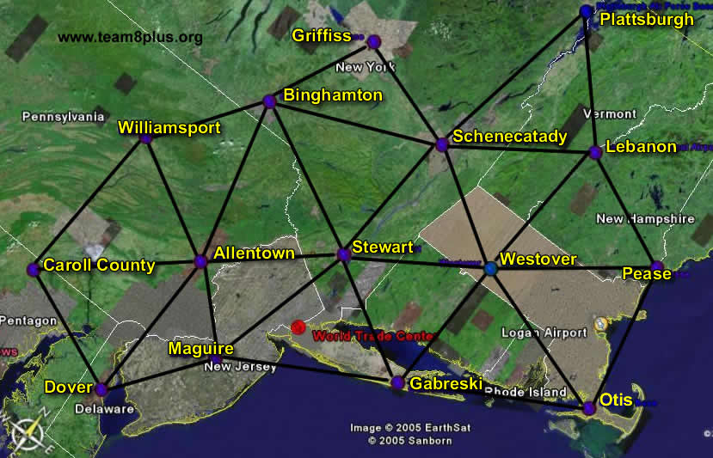
There is a network of military bases and airports on the East Coast laid out in triangles with a side of roughly 100 miles
Computer Science 2
BSc in Software Development Year 3 2006/07

Slide 3
Binary Tree: A node is pointed to by at most one other node (its parent), and each node points to at most two other nodes (its children)
General Tree: Remove the restriction that each node can have at most two children.
Graph: Remove also the restriction that each node may have one parent node.
Computer Science 2
BSc in Software Development Year 3 2006/07

Slide 4
Graph: A graph is made up of a set of nodes called vertices and a set of lines called edges (or arcs) that connect the nodes.
Definitions:
Graph: A data structure that consists of a set of nodes and a set of edges that relate the nodes to each other.
Vertex: A node in a graph.
Edge (Arc): A pair of vertices representing a connection between two nodes in a graph.
Undirected Graph: A graph in which the edges have no direction.
Directed Graph (Digraph): A graph in which each edge is directed from one vertex to another (or the same) vertex.
Computer Science 2
BSc in Software Development Year 3 2006/07

Slide 5
Examples:
Undirected Graph: A graph that represents roads between pairs of cities.
Directed Graph: Flights from on city to another.
In this course we are looking at a graph as an abstract data type => looking at
  how the graph might be implemented and
  how the algorithms that manipulate graphs make use of
      stacks,
      queues and
      priority queues.
Computer Science 2
BSc in Software Development Year 3 2006/07

Slide 6
Formal definition of a Graph: G = (V,E)
where
V(G) is a finite, nonempty set of vertices
E(G) is a set of edges (written as pairs of vertices)
Examples:
Graph1: an undirected graph
V(Graph1) = {A, B, C, D}
E(Graph1) {(A,B), (A,D), (B,C), (B,D)}
B
A
D
C
Computer Science 2
BSc in Software Development Year 3 2006/07

Slide 7
1
3
Graph2: a directed graph
V(Graph2) = {1, 3, 5, 7, 9, 11}
E(Graph2) = {(1,3), (3,1), (5,7), (5,9), (9,11), (11,1)}
Graph3: a directed graph
V(Graph3) = {A, B, C, D, E, F, G, H, I, J}
V(Graph3) = {(G,D), (G,I), (D,B), (D,F),
(I,H), (I,J), (B,A), (B,C), (F,E)}
Note: this is a special case
of a Graph – A Binary Search Tree.
11
5
7
9
G
D
I
B
F
H
J
A
C
E
Computer Science 2
BSc in Software Development Year 3 2006/07

Slide 8
Definitions:
Adjacent Nodes: two nodes in a graph that are connected by an edge.
Path: A sequence of vertices that connects two nodes in a graph.
Weighted Graph: A graph in which each edge carries a value.
Complete Graph: A graph in which every vertex is directly connected to every other vertex.
Note:
Complete Directed Graph with N vertices has N(N-1) edges.
Complete Undirected Graph with N vertices has N(N-1)/2 edges.
Computer Science 2
BSc in Software Development Year 3 2006/07

Slide 9
Examples:
Complete Directed Graph with 4 vertices has 4(4-1) = 12 edges.
A
B
C
D
Complete Undirected Graph with 5 vertices has 5(5-1)/2 = 10 edges.
J
K
N
L
M
Computer Science 2
BSc in Software Development Year 3 2006/07

Slide 10
Weighted Graph
The weights represents distances between pairs of cities
The edges represent Air Busters Airlines flights that connect the cities.
Dallas
200
1300
Austin
200
780
Washington
Denver
900
600
1400
600
1000
1000
Atlanta
Chicago
800
Houston
800
160
Computer Science 2
BSc in Software Development Year 3 2006/07

Slide 11
To see if we can get from Dallas to Houston, look for a path between them.
The total distance is determined by the sum of the weights on the edges on the path from Dallas to Houston.
Multiple paths may exist between two vertices =>
  Need to look at a shortest path algorithm
Also need graph searching algorithms
  Depth First Search
  Breadth First Search
First need to specify a graph ADT.
Computer Science 2
BSc in Software Development Year 3 2006/07

Slide 12
Graph ADT Specification
Structure:
The graph consists of a set of vertices and a set of weighted edges that connect some or all of the vertices.
Operations:
Assumption:
Before any call is made to a graph operation, the graph has been declared and a constructor has been applied.
Computer Science 2
BSc in Software Development Year 3 2006/07

Slide 13
MakeEmpty
Function: Initialize graph to the empty state.
Postcondition: Graph is empty.
Boolean IsEmpty
Function: Determines if the graph is empty.
Postcondition: Function value = (graph is empty)
Boolean IsFull
Function: Determines if the graph is full.
Postcondition: Function value = (graph is full)
Computer Science 2
BSc in Software Development Year 3 2006/07

Slide 14
AddVertex(VertexType vertex)
Function: Adds vertex to the graph.
Precondition: Graph is not full.
Postcondition: vertex is in V(graph)
AddEdge(VertexType fromVertex, VertexType toVertex, EdgeValueType weight)
Function: Adds an edge with the specified weight from
fromVertex to toVertex.
Precondition: fromVertex and toVertex are in V(graph)
Postcondition: (fromVertex, toVertex) is in E(graph) with the specified weight.
Computer Science 2
BSc in Software Development Year 3 2006/07

Slide 15
EdgeValueType WeightIs(VertexType fromVertex, VertexType toVertex)
Function: Determines the weight of the edge from
fromVertex to toVertex.
Precondition: fromVertex and toVertex are in V(graph)
Postcondition: Function value = weight of (fromVertex, toVertex).
GetToVertices(VertexType vertex, QueType& vertexQ)
Function: Returns a queue of the vertices that are adjacent from vertex.
Precondition: vertex is in V(graph).
Postcondition: vertexQ contains the names of all the vertices that are heads of edges for which vertex is the tail.
Computer Science 2
BSc in Software Development Year 3 2006/07

Slide 16
Application Level
Depth-First Strategy:
  like preorder tree traversal which goes down to the deepest level and works up.
Breadth-First Strategy:
  visit each vertex on level 0, then each vertex on level 1, then on level 2 and so on.
Computer Science 2
BSc in Software Development Year 3 2006/07

Slide 17
Depth-First Searching:
Develop an algorithm that finds a path from startVertex to endVertex
Examine the first vertex that is adjacent from startVertex.
If this is endVertex, the search is over.
Otherwise, examine all the vertices adjacent to this vertex, before coming back to check the 2nd vertex adjacent to startVertex, etc.
Applying a Depth-First Strategy travels as far as possible down one path, backtracking if the endVertex is not found.
In order to implement a Depth-First Strategy, a stack data structure is required for storing the vertices for backtracking.
Computer Science 2
BSc in Software Development Year 3 2006/07

Slide 18
Dallas
200
1300
Austin
200
780
Washington
Denver
900
600
1400
600
1000
1000
Atlanta
Chicago
800
Houston
800
160
startVertex = Austin endVertex = Washington
Contents of the Stack:
Houston
Atlanta
Washington
Austin
Empty
Dallas
Dallas
Dallas
Dallas
Dallas
Dallas
Note: Need to mark vertices already visited in order not to get caught in an infinite loop.
Computer Science 2
BSc in Software Development Year 3 2006/07

Slide 19
Depth-First Search:
Set found to false
For all vertices, clear marks
stack.Push (startVertex)
Do
stack.Pop (vertex)
If vertex = endVertex
output final vertex
set found to true
Else
if vertex is not marked
mark vertex
output this vertex
push all adjacent unmarked vertices onto stack
While !stack.IsEmpty() and !found
If (!found)
write “Path does not exist”
Computer Science 2
BSc in Software Development Year 3 2006/07

Slide 20
3 additional functions should be added to the graph ADT
ClearMarks
Function: Sets marks for all vertices to false.
Postcondition: All marks have been set to false.
MarkVertex(VertexType vertex)
Function: Sets mark for vertex to true.
Precondition: vertex is in V(graph).
Postcondition: IsMarked(vertex) is true.
Boolean IsMarked(VertexType vertex)
Function: Determines if vertex has been marked.
Precondition: vertex is in V(graph).
Postcondition: Function value = (vertex is marked true)
Computer Science 2
BSc in Software Development Year 3 2006/07

Slide 21
Depth-First Search:
template<class VertexType>
void DepthFirstSearch(GraphType<VertexType> graph,
VertexType startVertex, VertexType endVertex)
// Assumes VertexType is a type for which the “==“ and “<<“
// operators are defined.
{
StackType<VertexType> stack;
QueType<VertexType> vertexQ;
bool found = false;
VertexType vertex;
VertexType item;
Computer Science 2
BSc in Software Development Year 3 2006/07

Slide 22
graph.ClearMarks();
stack.Push(startVertex);
do
{
stack.Pop(vertex);
if (vertex == endVertex)
{
cout << vertex;
found = true;
}
Computer Science 2
BSc in Software Development Year 3 2006/07

Slide 23
else
{
if (!graph.IsMarked(vertex))
{
graph.MarkVertex(vertex);
cout << vertex;
graph.GetToVertices(vertex, vertexQ);
while (!vertexQ.IsEmpty())
{
vertexQ.Dequeue(item);
if (!graph.IsMarked(item))
stack.Push(item);
}
}
Computer Science 2
BSc in Software Development Year 3 2006/07

Slide 24
}
} while (!stack.IsEmpty() && !found);
if (!found)
cout << "Path not found." << endl;
}
Note: The names of all the vertices visited during the search are output.
We can write this application without knowing how the graph is stored.
Computer Science 2
BSc in Software Development Year 3 2006/07

Slide 25
Breadth-First Search:
Looks at all possible paths at the same depth before going to a deeper level.
In our flight example, a Breadth-First Search checks all possible one-stop connections before checking two-stop connections
Most travelers would prefer this approach when booking flights!
Dead end:
Depth-First Search => back up as little as possible => Stack LIFO
Breadth-First Search => back up as far as possible => Queue FIFO
Computer Science 2
BSc in Software Development Year 3 2006/07

Slide 26
The Depth-First Search can be modified to become a Breadth-First Search by changing the stack operations to queue operations.
Computer Science 2
BSc in Software Development Year 3 2006/07

Slide 27
Breadth-First Search:
template<class VertexType>
void BreadthFirstSearch(
GraphType<VertexType> graph,
VertexType startVertex,
VertexType endVertex)
// Assumes VertexType is a type for which the “==“ and “<<“
// operators are defined.
{
QueType<VertexType> queue;
QueType<VertexType> vertexQ;
bool found = false;
VertexType vertex;
VertexType item;
Computer Science 2
BSc in Software Development Year 3 2006/07

Slide 28
graph.ClearMarks();
queue.Enqueue(startVertex);
do
{
queue.Dequeue(vertex);
if (vertex == endVertex)
{
cout << vertex;
found = true;
}
Computer Science 2
BSc in Software Development Year 3 2006/07

Slide 29
else
{
if (!graph.IsMarked(vertex))
{
graph.MarkVertex(vertex);
cout << vertex;
graph.GetToVertices(vertex, vertexQ);
while (!vertexQ.IsEmpty())
{
vertexQ.Dequeue(item);
if (!graph.IsMarked(item))
queue.Enqueue(item);
}
}
Computer Science 2
BSc in Software Development Year 3 2006/07

Slide 30
}
} while (!queue.IsEmpty() && !found);
if (!found)
cout << "Path not found." << endl;
}
Note: The names of all the vertices visited during the search are output.
Again this application is written without knowing how the graph is stored.
Computer Science 2
BSc in Software Development Year 3 2006/07

Slide 31
Dallas
200
1300
Austin
200
780
Washington
Denver
900
600
1400
600
1000
1000
Atlanta
Chicago
800
Houston
800
160
startVertex = Austin endVertex = Washington
Contents of the Queue:
Austin
Rear of Queue
Empty
Houston
Dallas
Denver
Chicago
Houston
Atlanta
Denver
Chicago
Denver
Atlanta
Denver
Atlanta
Denver
Atlanta
Front of Queue
Washington
Atlanta
Denver
Washington
Atlanta
Washington
Computer Science 2
BSc in Software Development Year 3 2006/07

Slide 32
Depth-First Search:
1
3
5
7
9
2
4
6
8
10
startVertex = 1 endVertex = 10
Stack Contents:
9
8
10
8
8
8
3
6
7
5
5
5
1
Empty
2
2
2
2
2
2
Output: 1 3 6 7 9 8 10
Computer Science 2
BSc in Software Development Year 3 2006/07

Slide 33
Breadth-First Search:
1
3
5
7
9
2
4
6
8
10
startVertex = 1 endVertex = 10
Computer Science 2
BSc in Software Development Year 3 2006/07

Slide 34
1
3
5
7
9
1
Empty
3
2
2
4
6
8
10
4
3
6
4
Queue Contents:
5
6
7
5
7
Empty
9
8
10
9
10
Empty
Output: 1 2 3 4 6 5 7 8 9 10
Computer Science 2
BSc in Software Development Year 3 2006/07

Slide 35
The Single Source Shortest Path Problem:
Multiple paths from one vertex to another.
Want to find the shortest path from one vertex which we identify as the startVertex to each of the other vertices in the graph.
It turns out to be as easy to solve this more general problem rather than finding the shortest path from a particular startVertex to a particular endVertex.
By Shortest Path we mean the path whose edge values (weights), added together have the smallest sum.
Computer Science 2
BSc in Software Development Year 3 2006/07

Slide 36
Example: Two Paths from Austin to Washington
 |  |  | Austin
Austin |  |  |  | 200 miles
 | 160 miles |  | Dallas
Houston |  |  |  | 780 miles
 | 800 miles |  | Denver
Atlanta |  |  |  | 1400 miles
 | 600 miles |  | Atlanta
Washington |  |  |  | 600 miles
 |  |  | Washington
Total | 1560 miles |  | Total | 2980 miles
Clearly, the first path is preferable but is it the shortest path?
Computer Science 2
BSc in Software Development Year 3 2006/07

Slide 37
Greedy Algorithm for finding Shortest Path:
0
0
0
2
3
5
2
3
5
2
5
d = 2
6
3
6
4
1
4
10
1
4
1
6
1
d = 2
d = 5
10
d = 5
4
2
4
3
2
2
d = ∞
3
2
d = 3
d = 6
3
2
d = 3
S = {0}
S = {0,4}
0
0
0
5
2
3
5
2
2
3
d = 2
3
d = 2
d = 2
4
1
4
1
4
1
6
1
d = 4
d = 4
1
d = 4
1
4
3
2
3
2
2
d = 3
3
2
d = 3
2
d = 3
d = 5
d = 5
2
d = 5
S = {0,4,2,1}
S = {0,4,2,1,3}
S = {0,4,2}
Computer Science 2
BSc in Software Development Year 3 2006/07

Slide 38
Method:
Use a priority queue (implemented using a minimum heap), as we always want to retrieve the vertex that is closest to the startVertex.
The items on the priority queue are struct variables with 3 data members fromVertex, toVertex, distance (from startVertex).
Shortest Path Algorithm:
Graph.ClearMarks()
Set item.fromVertex to startVertex
Set item.toVertex to startVertex
Set item.distance to 0
Pq.Enqueue(item)
Computer Science 2
BSc in Software Development Year 3 2006/07

Slide 39
Do pq.Dequeue (item)
If item.toVertex is not marked
mark item.toVertex
output item.fromVertex, item.toVertex, item.distance
set item.fromVertex to item.toVertex
set minDistance to item.distance
get queue vertexQ of vertices adjacentfrom item.fromVertex
While more vertices in vertexQ
get next vertex from VertexQ
If vertex is not marked
set item.toVertex to vertex
set item.distance to minDistance + graph.WeightIs(fromVertex,vertex)
pq.Enqueue(item) While !pq.IsEmpty()
Computer Science 2
BSc in Software Development Year 3 2006/07

Slide 40
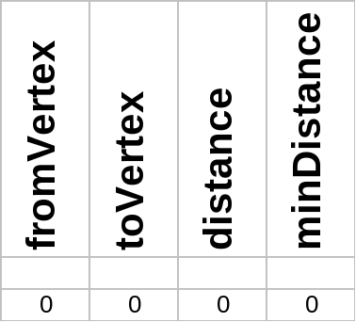
Example Shortest Path:
0
2
3
5
6
4
10
1
6
1
2
4
3
2
2
Computer Science 2
BSc in Software Development Year 3 2006/07

Slide 41
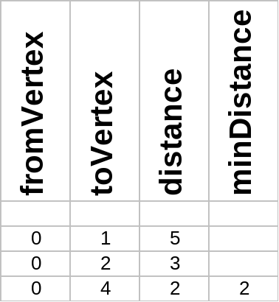
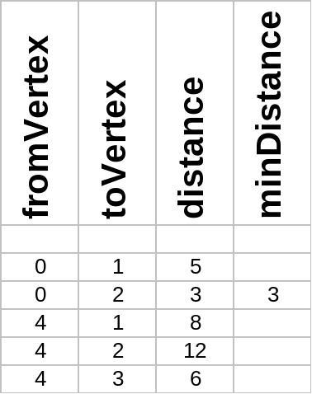
0
0
2
3
5
2
5
d = 2
6
3
4
1
4
1
d = 2
d = 5
10
d = 5
4
d = ∞
3
2
d = 3
d = 6
3
2
d = 3
S = {0}
S = {0,4}
Computer Science 2
BSc in Software Development Year 3 2006/07

Slide 42
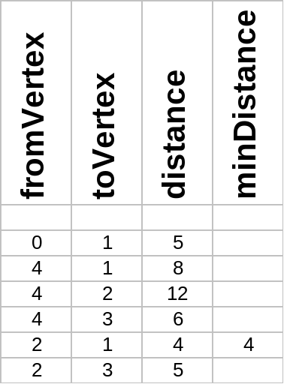
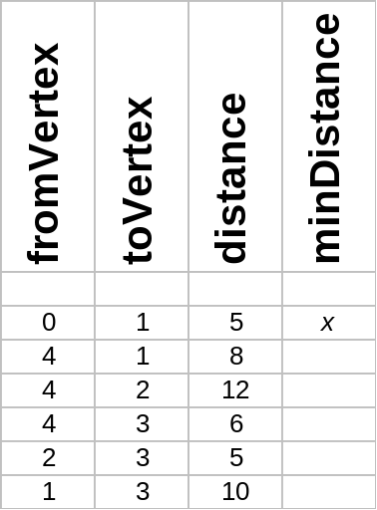
0
0
5
2
3
5
2
3
d = 2
d = 2
6
4
6
1
4
1
10
6
1
d = 4
10
1
d = 4
4
4
3
2
3
2
2
d = 3
2
d = 3
d = 5
d = 5
S = {0,4,2}
S = {0,4,2,1}
Computer Science 2
BSc in Software Development Year 3 2006/07

Slide 43
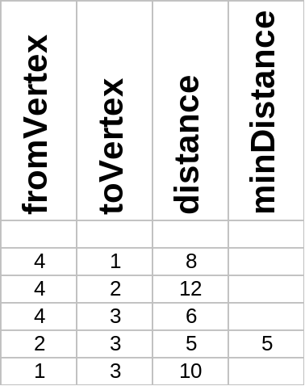
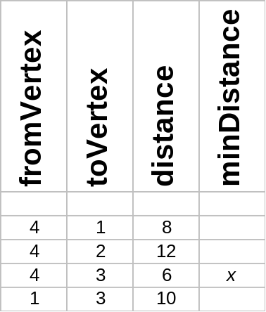
0
0
2
3
2
d = 2
3
6
d = 2
6
4
10
1
4
1
6
1
d = 4
10
6
d = 4
4
4
1
3
2
2
d = 3
3
2
d = 3
d = 5
d = 5
2
S = {0,4,2,1}
S = {0,4,2,1,3}
Computer Science 2
BSc in Software Development Year 3 2006/07

Slide 44
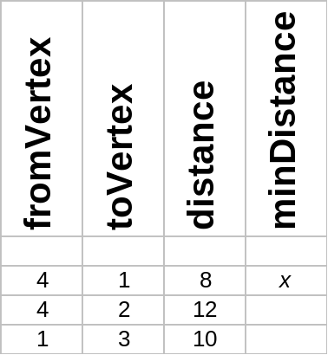
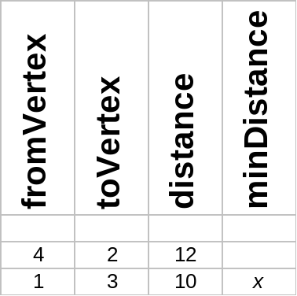
0
0
2
3
2
3
d = 2
6
d = 2
4
1
4
1
10
6
1
d = 4
10
6
1
d = 4
d = 5
3
2
d = 3
d = 5
3
2
d = 3
2
2
S = {0,4,2,1,3}
S = {0,4,2,1,3}
Computer Science 2
BSc in Software Development Year 3 2006/07

Slide 45
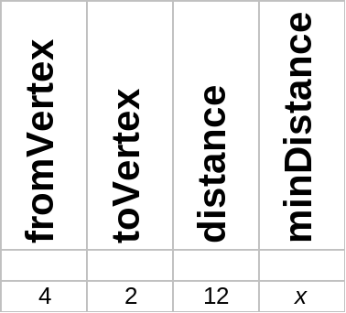
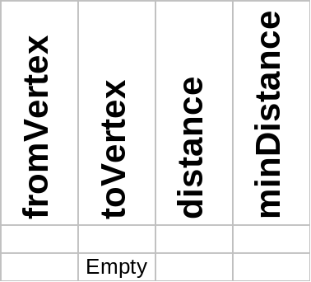
0
0
2
3
2
3
d = 2
d = 2
4
1
4
1
10
1
d = 4
1
d = 4
d = 5
3
2
d = 3
d = 5
3
2
d = 3
2
2
S = {0,4,2,1,3}
S = {0,4,2,1,3}
Computer Science 2
BSc in Software Development Year 3 2006/07

Slide 46
0
2
3
4
1
1
3
2
2
OutPut:
LastVertex | Destination | Distance
0 | 0 | 0
0 | 4 | 2
0 | 2 | 3
2 | 1 | 4
2 | 3 | 5
Computer Science 2
BSc in Software Development Year 3 2006/07

Slide 47
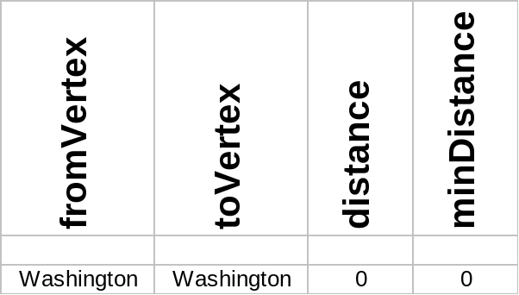
Airline Example Shortest Path:
Dallas
200
1300
Austin
200
780
Washington
Denver
900
600
1400
600
1000
1000
Atlanta
Chicago
800
Houston
800
160
Computer Science 2
BSc in Software Development Year 3 2006/07

Slide 48
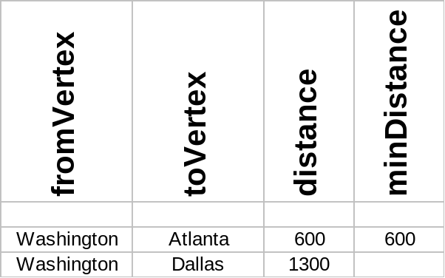
Dallas
1300
Austin
Washington
Denver
600
Atlanta
Chicago
Houston
Computer Science 2
BSc in Software Development Year 3 2006/07

Slide 49
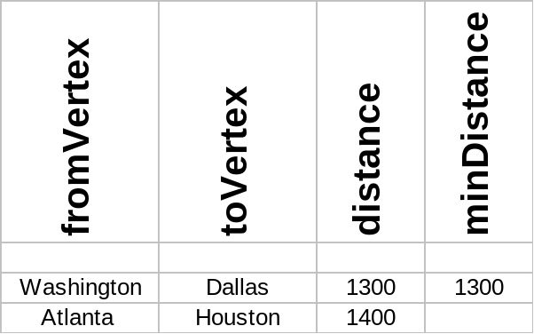
Dallas
1300
Austin
Washington
Denver
600
Atlanta
Chicago
800
Houston
Computer Science 2
BSc in Software Development Year 3 2006/07

Slide 50
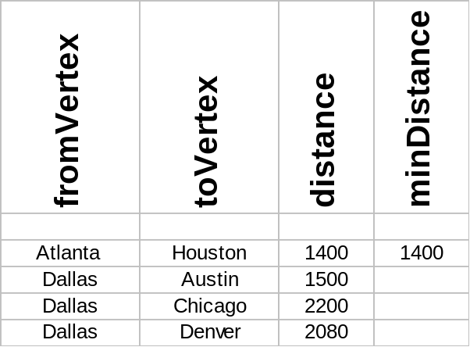
Dallas
1300
Austin
200
780
Washington
Denver
900
600
Atlanta
Chicago
800
Houston
Computer Science 2
BSc in Software Development Year 3 2006/07

Slide 51
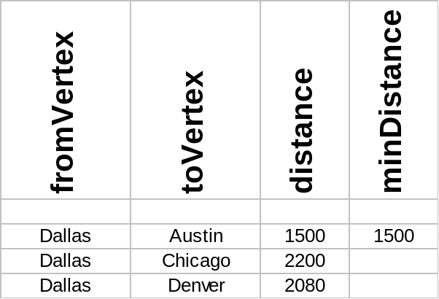
Dallas
1300
Austin
200
780
Washington
Denver
900
600
Atlanta
Chicago
800
Houston
Computer Science 2
BSc in Software Development Year 3 2006/07

Slide 52
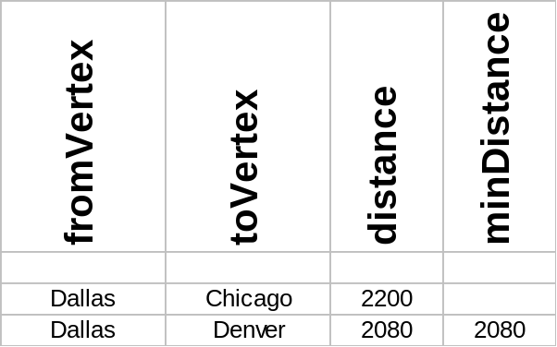
Dallas
1300
Austin
200
780
Washington
Denver
900
600
Atlanta
Chicago
800
Houston
Computer Science 2
BSc in Software Development Year 3 2006/07

Slide 53
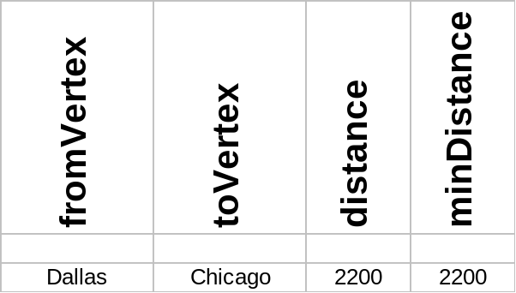
Dallas
1300
Austin
200
780
Washington
Denver
900
600
Atlanta
Chicago
800
Houston
Computer Science 2
BSc in Software Development Year 3 2006/07

Slide 54
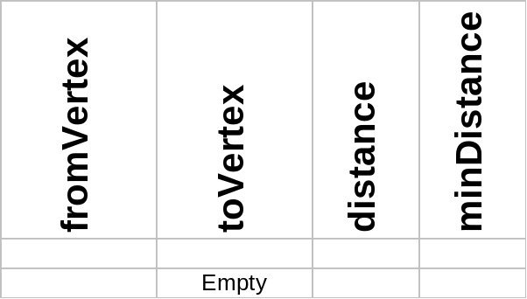
Dallas
1300
Austin
200
780
Washington
Denver
900
600
Atlanta
Chicago
800
Houston
Computer Science 2
BSc in Software Development Year 3 2006/07

Slide 55
Dallas
1300
Austin
200
780
Washington
Denver
600
900
Chicago
Atlanta
800
OutPut:
Houston
LastVertex | Destination | Distance
Washington | Washington | 0
Washington | Atlanta | 600
Washington | Dallas | 1300
Atlanta | Houston | 1400
Dallas | Austin | 1500
Dallas | Denver | 2080
Dallas | Chicago | 2200
Computer Science 2
BSc in Software Development Year 3 2006/07

Slide 56
Shortest Path Implementation:
template<class VertexType>
struct ItemType
{
bool operator<(ItemType otherItem);
// < means greater distance
bool operator==(ItemType otherItem);
bool operator<=(ItemType otherItem);
VertexType fromVertex;
VertexType toVertex;
int distance;
};
Computer Science 2
BSc in Software Development Year 3 2006/07

Slide 57
template<class VertexType>
void ShortestPath(GraphType<VertexType> graph,
VertexType startVertex)
{
ItemType item;
int minDistance;
PQType<ItemType> pq(10); // Assume at most 10 vertices
QueType<VertexType> vertexQ;
VertexType vertex;
int count = 0;
Computer Science 2
BSc in Software Development Year 3 2006/07

Slide 58
graph.ClearMarks();
item.fromVertex = startVertex;
item.toVertex = startVertex;
item.distance = 0;
pq.Enqueue(item);
cout << “Last Vertex Destination Distance” << endl;
cout << “----------------------------------” << endl;
Computer Science 2
BSc in Software Development Year 3 2006/07

Slide 59
do
{
pq.Dequeue(item);
if (!graph.IsMarked(item.toVertex))
{
graph.MarkVertex(item.toVertex);
cout << item.fromVertex;
cout << " ";
cout << item.toVertex;
cout << " " << item.distance << endl;
item.fromVertex = item.toVertex;
minDistance = item.distance;
graph.GetToVertices(item.fromVertex, vertexQ);
Computer Science 2
BSc in Software Development Year 3 2006/07

Slide 60
while (!vertexQ.IsEmpty()) {
vertexQ.Dequeue(vertex);
if (!graph.IsMarked(vertex))
{
item.toVertex = vertex;
item.distance = minDistance + graph.WeightIs(item.fromVertex, vertex);
pq.Enqueue(item);
}
} }
} while (!pq.IsEmpty()); }
Computer Science 2
BSc in Software Development Year 3 2006/07

Slide 61
Note:
The code for finding the shortest path can be modified to give a
    Minimum Spanning Tree
    Depth-First Spanning Tree
    Breadth-First Spanning Tree
The value corresponding to distance on the priority queue is altered depending on which algorithm we require.
Computer Science 2
BSc in Software Development Year 3 2006/07

Slide 62
Minimum Spanning Tree
A minimum spanning tree (MST) or minimum weight spanning tree is a spanning tree connecting all vertices with weight less than or equal to the weight of every other spanning tree. (i.e. the lowest “cost” way to connect all the points).
One example would be a cable TV company laying cable to a new neighbourhood. If it is constrained to bury the cable only along certain paths, then there would be a graph representing which points are connected by those paths. Some of those paths might be more expensive, because they are longer, or require the cable to be buried deeper; these paths would be represented by edges with larger weights. A spanning tree for that graph would be a subset of those paths that has no cycles but still connects to every house. There might be several spanning trees possible. A minimum spanning tree would be one with the lowest total cost.
Computer Science 2
BSc in Software Development Year 3 2006/07

Slide 63
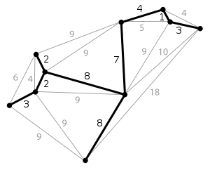
Minimum Spanning Tree
Computer Science 2
BSc in Software Development Year 3 2006/07

Slide 64
while (!vertexQ.IsEmpty()) {
vertexQ.Dequeue(vertex);
if (!graph.IsMarked(vertex))
{
item.toVertex = vertex;
item.distance = minDistance + graph.WeightIs(item.fromVertex, vertex);
pq.Enqueue(item);
}
} }
} while (!pq.IsEmpty()); }
Shortest Path
Computer Science 2
BSc in Software Development Year 3 2006/07

Slide 65
while (!vertexQ.IsEmpty()) {
vertexQ.Dequeue(vertex);
if (!graph.IsMarked(vertex))
{
item.toVertex = vertex;
item.distance = graph.WeightIs(item.fromVertex, vertex);
pq.Enqueue(item);
}
} }
} while (!pq.IsEmpty()); }
Minimum Spanning Tree
Computer Science 2
BSc in Software Development Year 3 2006/07

Slide 66
while (!vertexQ.IsEmpty()) {
vertexQ.Dequeue(vertex);
if (!graph.IsMarked(vertex))
{
item.toVertex = vertex;
item.distance = -(++count);
pq.Enqueue(item);
}
} }
} while (!pq.IsEmpty()); }
Depth-First Spanning Tree
Forces the priority queue to function like a stack.
Computer Science 2
BSc in Software Development Year 3 2006/07

Slide 67
while (!vertexQ.IsEmpty()) {
vertexQ.Dequeue(vertex);
if (!graph.IsMarked(vertex))
{
item.toVertex = vertex;
item.distance = (++count);
pq.Enqueue(item);
}
} }
} while (!pq.IsEmpty()); }
Breadth-First Spanning Tree
Forces the priority queue to function like a queue.
Computer Science 2
BSc in Software Development Year 3 2006/07

Slide 68
Minimum Spanning Tree:
As we have just seen, the code for Shortest path can be easily modified to give a Minimum Spanning Tree.
Edges are put on the priority queue with their own weight rather than their distance from the start vertex.
Computer Science 2
BSc in Software Development Year 3 2006/07

Slide 69
Example Minimum Spanning Tree:
0
2
3
5
6
4
10
1
6
1
2
4
3
2
2
Computer Science 2
BSc in Software Development Year 3 2006/07

Slide 70

0
0
2
3
5
2
5
d = 2
6
3
4
1
4
1
d = 2
d = 5
10
d = 5
4
d = ∞
3
2
d = 3
d = 4
3
2
d = 3
S = {0}
S = {0,4}
Computer Science 2
BSc in Software Development Year 3 2006/07

Slide 71


0
0
5
2
5
2
3
d = 2
3
d = 2
6
4
6
1
4
1
10
6
1
d = 1
10
1
d = 1
4
4
3
2
3
2
2
d = 3
2
d = 3
d = 2
d = 2
S = {0,4,2}
S = {0,4,2,1}
Computer Science 2
BSc in Software Development Year 3 2006/07

Slide 72
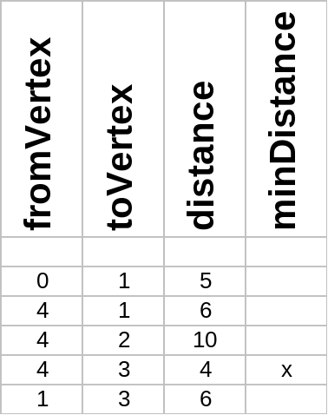
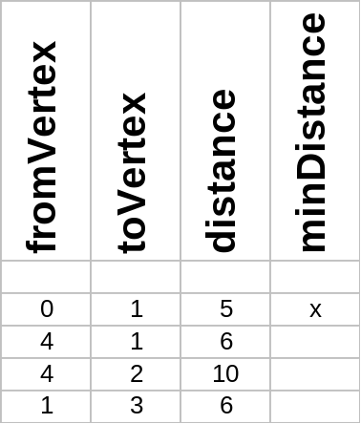
0
5
0
2
3
2
5
d = 2
3
6
d = 2
6
4
10
1
4
1
6
1
d = 1
10
6
d = 1
4
1
3
2
2
d = 3
3
2
d = 3
d = 2
d = 2
2
S = {0,4,2,1,3}
S = {0,4,2,1,3}
Computer Science 2
BSc in Software Development Year 3 2006/07

Slide 73
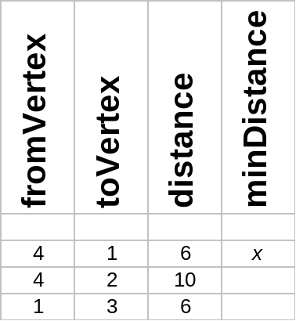
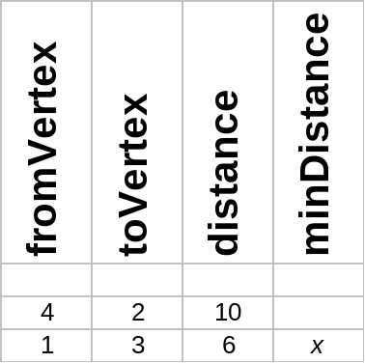
0
0
2
3
2
3
d = 2
6
d = 2
4
1
4
1
10
6
1
d = 1
10
6
1
d = 1
d = 2
3
2
d = 3
d = 2
3
2
d = 3
2
2
S = {0,4,2,1,3}
S = {0,4,2,1,3}
Computer Science 2
BSc in Software Development Year 3 2006/07

Slide 74

0
0
2
3
2
3
d = 2
d = 2
4
1
4
1
10
1
d = 1
1
d =1
d = 2
3
2
d = 3
d = 2
3
2
d = 3
2
2
S = {0,4,2,1,3}
S = {0,4,2,1,3}
Computer Science 2
BSc in Software Development Year 3 2006/07

Slide 75
0
Note: In General the Minimum Spanning Tree will not be the same as the Shortest Path
2
3
4
1
1
3
2
2
OutPut:
LastVertex | Destination | Distance
0 | 0 | 0
0 | 4 | 2
0 | 2 | 3
2 | 1 | 1
2 | 3 | 2
Computer Science 2
BSc in Software Development Year 3 2006/07

Slide 76
Airline Example Minimum Spanning Tree:
Dallas
200
1300
Austin
200
780
Washington
Denver
900
600
1400
600
1000
1000
Atlanta
Chicago
800
Houston
800
160
Computer Science 2
BSc in Software Development Year 3 2006/07

Slide 77
Dallas
1300
Austin
Washington
Denver
600
Atlanta
Chicago
Houston
Computer Science 2
BSc in Software Development Year 3 2006/07

Slide 78
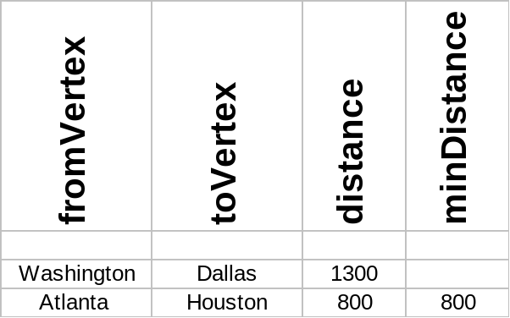
Dallas
1300
Austin
Washington
Denver
600
Atlanta
Chicago
800
Houston
Computer Science 2
BSc in Software Development Year 3 2006/07

Slide 79
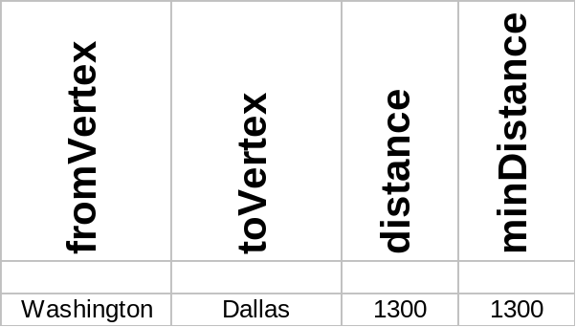
Dallas
1300
Austin
200
780
Washington
Denver
900
600
Atlanta
Chicago
800
Houston
Computer Science 2
BSc in Software Development Year 3 2006/07

Slide 80
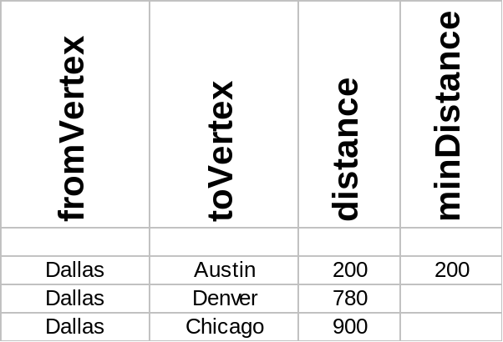
Dallas
1300
Austin
200
780
Washington
Denver
900
600
Atlanta
Chicago
800
Houston
Computer Science 2
BSc in Software Development Year 3 2006/07

Slide 81
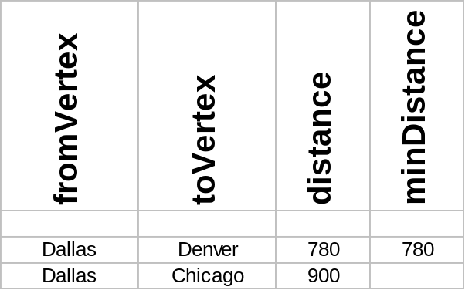
Dallas
1300
Austin
200
780
Washington
Denver
900
600
Atlanta
Chicago
800
Houston
Computer Science 2
BSc in Software Development Year 3 2006/07

Slide 82
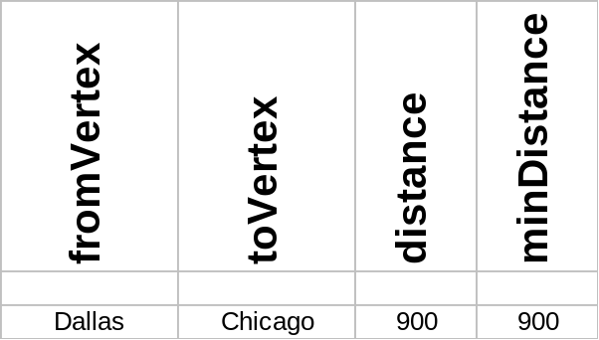
Dallas
1300
Austin
200
780
Washington
Denver
900
600
Atlanta
Chicago
800
Houston
Computer Science 2
BSc in Software Development Year 3 2006/07

Slide 83
Dallas
1300
Austin
200
780
Washington
Denver
900
600
Atlanta
Chicago
800
Houston
Computer Science 2
BSc in Software Development Year 3 2006/07

Slide 84
Dallas
1300
Austin
200
780
Washington
Denver
600
900
Chicago
Atlanta
800
OutPut:
Houston
LastVertex | Destination | Distance
Washington | Washington | 0
Washington | Atlanta | 600
Atlanta | Houston | 800
Washington | Dallas | 1300
Dallas | Austin | 200
Dallas | Denver | 780
Dallas | Chicago | 900
Computer Science 2
BSc in Software Development Year 3 2006/07

Slide 85
Example Depth-First Traversal:
Edges are put onto the priority queue with minus their count value to force the priority queue to function as a stack.
count is initialized to 0 and incremented before each edge is put on the priority queue.
0
2
3
5
6
4
10
1
6
1
2
4
3
2
2
Computer Science 2
BSc in Software Development Year 3 2006/07

Slide 86

0
0
2
3
5
2
3
5
6
4
1
4
10
1
6
1
2
4
3
2
2
3
2
Computer Science 2
BSc in Software Development Year 3 2006/07

Slide 87
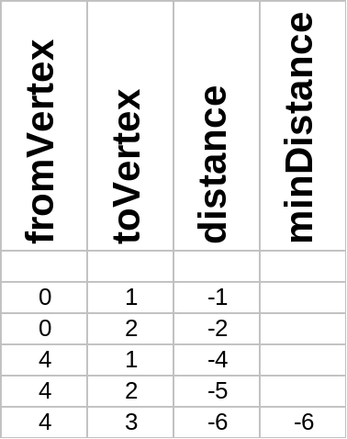
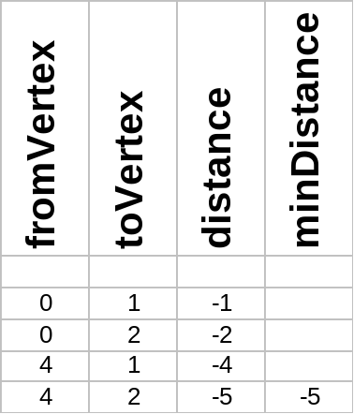
0
0
2
5
2
3
5
3
6
6
4
1
4
1
10
10
4
4
3
2
3
2
Computer Science 2
BSc in Software Development Year 3 2006/07

Slide 88

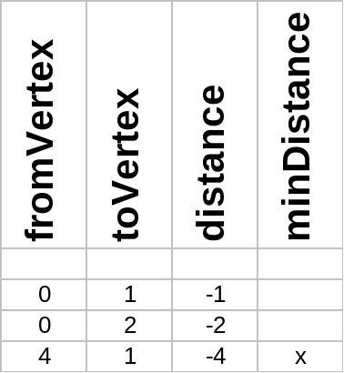
0
2
5
0
3
2
5
6
3
4
1
6
10
4
1
4
1
10
4
1
3
2
3
2
Computer Science 2
BSc in Software Development Year 3 2006/07

Slide 89

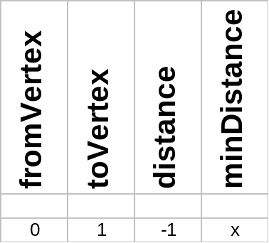
0
2
5
0
3
2
5
4
10
1
1
4
10
1
4
1
4
3
2
3
2
Computer Science 2
BSc in Software Development Year 3 2006/07

Slide 90
0
OutPut:
2
4
10
1
4
1
3
2
LastVertex | Destination | Distance
0 | 0 | 0
0 | 4 | -3
4 | 3 | -6
4 | 2 | -5
2 | 1 | -7
Computer Science 2
BSc in Software Development Year 3 2006/07

Slide 91
Example Breadth-First Traversal:
Edges are put onto the priority queue with their count value to force the priority queue to function as a queue.
Again, count is initialized to 0 and incremented before each edge is put on the priority queue.
0
2
3
5
6
4
10
1
6
1
2
4
3
2
2
Computer Science 2
BSc in Software Development Year 3 2006/07

Slide 92
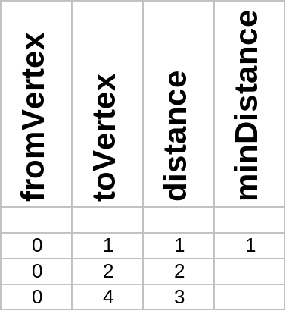
0
0
2
3
5
2
5
3
6
4
10
1
4
1
6
1
2
4
3
2
2
3
2
Computer Science 2
BSc in Software Development Year 3 2006/07

Slide 93

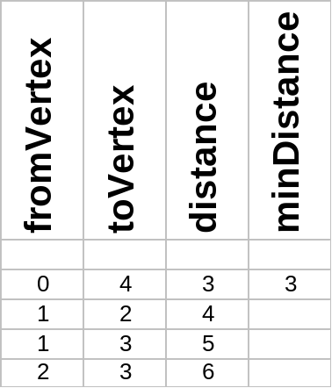
0
0
2
3
5
2
3
5
4
1
4
1
6
2
6
2
3
2
3
2
2
Computer Science 2
BSc in Software Development Year 3 2006/07

Slide 94
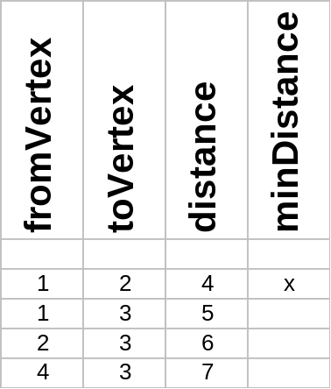

0
0
2
3
5
2
3
5
4
1
4
1
6
2
6
4
4
3
2
2
3
2
2
Computer Science 2
BSc in Software Development Year 3 2006/07

Slide 95
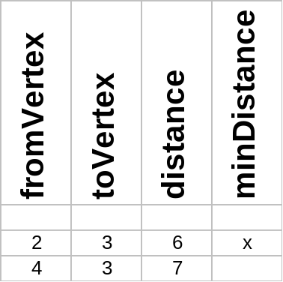
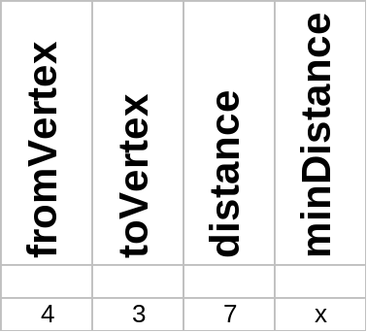
0
0
2
3
5
2
3
5
4
1
4
1
6
6
4
4
3
2
2
3
2
Computer Science 2
BSc in Software Development Year 3 2006/07

Slide 96
0
2
3
5
OutPut:
4
1
6
3
2
LastVertex | Destination | Distance
0 | 0 | 0
0 | 1 | 1
0 | 2 | 2
0 | 4 | 3
1 | 3 | 5
Computer Science 2
BSc in Software Development Year 3 2006/07

